Slide 1


Project Based Learning: Predicting Bitcoin Prices using Deep Learning
Under The Guidance Of: Presented By:
Mrs. M. Jyothi Rani R Sivaram [4511-19-733-008]
M Shiva [4511-19-733-041]
B Srivani [4511-19-733-004]

Slide 2
CONTENTS
ABSTRACT
INTRODUCTION
EXISTING SYSTEM
-Disadvantages
PROPOSED SYSTEM
-Advantages
SYSTEM REQUIREMENTS
SYSTEM ARCHITECTURE
MODULES
CONCLUSION
REFERENCES

Slide 3
ABSTRACT
With the rise of the crypto digital era more heads have turned towards the digital market for investments.
This gives us the opportunity to create a model capable of predicting crypto currencies primarily Bitcoin.
With vast amount of data being generated and recorded on a daily basis, we have finally come close to an era where predictions can be accurate.
The goal for this innovative undergrad project is to show how a trained machine model can predict the price of a cryptocurrency if we give the right amount of data and computational power.

Slide 4
INTRODUCTION
In general, cryptocurrencies are just lines of code that can have some financial value. Bitcoin is the first cryptocurrency that was created.
Bitcoin’s price has arguably behaved like a bubble. Many people have been scrambling to find ways to make money off this volatile market.
After the recent popularity of bitcoins, many researchers have tried to implement prediction models [1].
Many parameters must be tweaked until at least some sensible outcome is generated from the algorithm during building a prediction model.

Slide 5
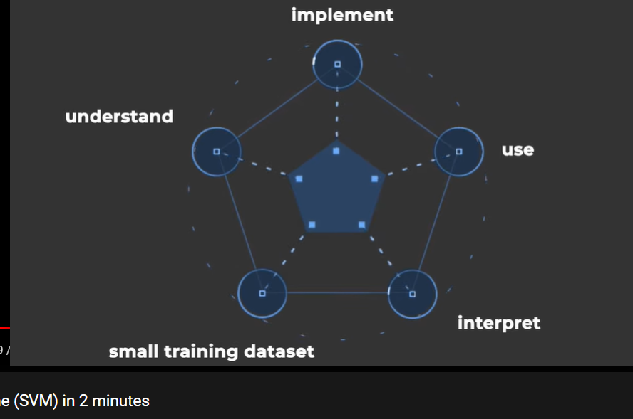
EXISTING SYSTEM
In particular, support vector machines (SVM) are suggested to work well with small data and this have been used widely in the asset returns prediction problems [2].
DISADVANTAGES
It does not perform well, when we have
large data set.
Low performance if the data set has more
noise.

Slide 6
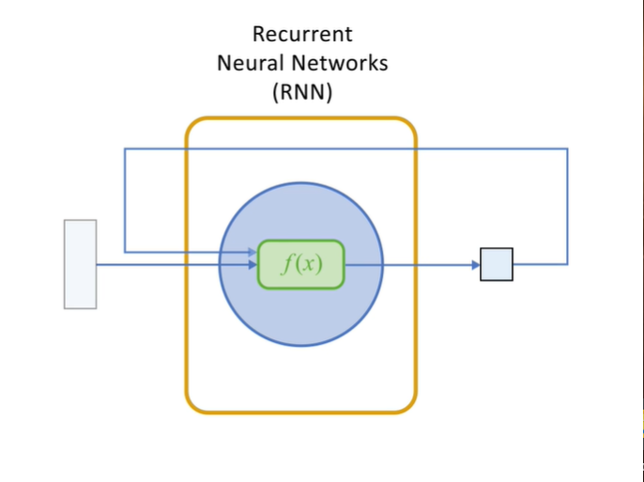
PROPOSED SYSTEM
Recurrent neural network’s(RNN’s) LSTM is proposed model.
ADVANTAGES
It is easily calculate the large data set prices.
The proposed method is capable of tracing and
prediction of prices and the prediction will produce
higher and accurate results.
With our above model we are getting accurate results
which will be more useful to stock analysts, Business
Analysts, Stock Market Investors.

Slide 7
SYSTEM REQUIREMENTS
Hardware requirements :
Processor: Intel I3 or Higher Gen
RAM: Min. 4GB
Hard Disk: Min. 256 GB
Software requirements :
Operating System: Windows 7 or Higher Versions
Programming Language: Python
Execution Platform: Jupyter Notebook / Spyder IDE

Slide 8
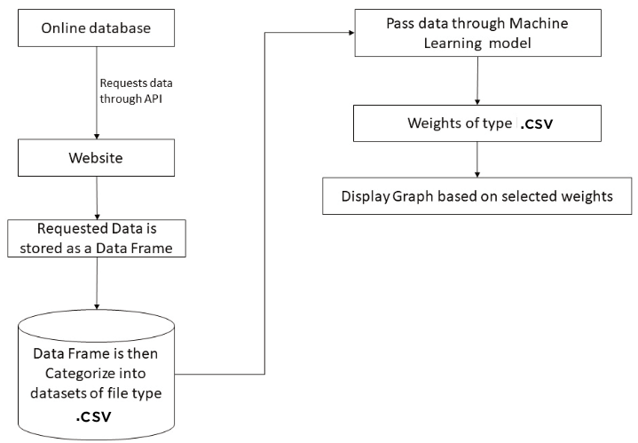
SYSTEM ARCHITECTURE

Slide 9
MODULES
Data Collection
Data Categorization
Data Preprocessing
Model Implementation & Predicting

Slide 10
Data Collection
Data collection is the process of gathering data, information or any variables of interest in a standardized and established manner.
Data collection enables the collector to answer or test hypothesis and evaluate outcomes of the particular collection.
Since this project aim is to predict Bitcoin Prices, the historical data which was generated is the Sequential data.
The data we collected for this project purpose is from “Yahoo Finance” website [4].

Slide 11
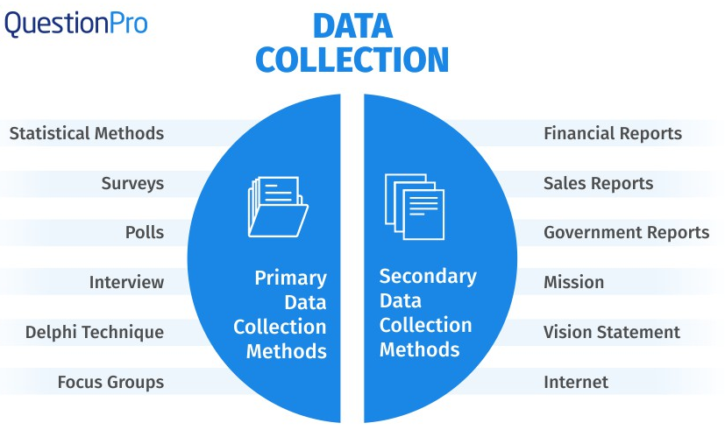








Slide 12
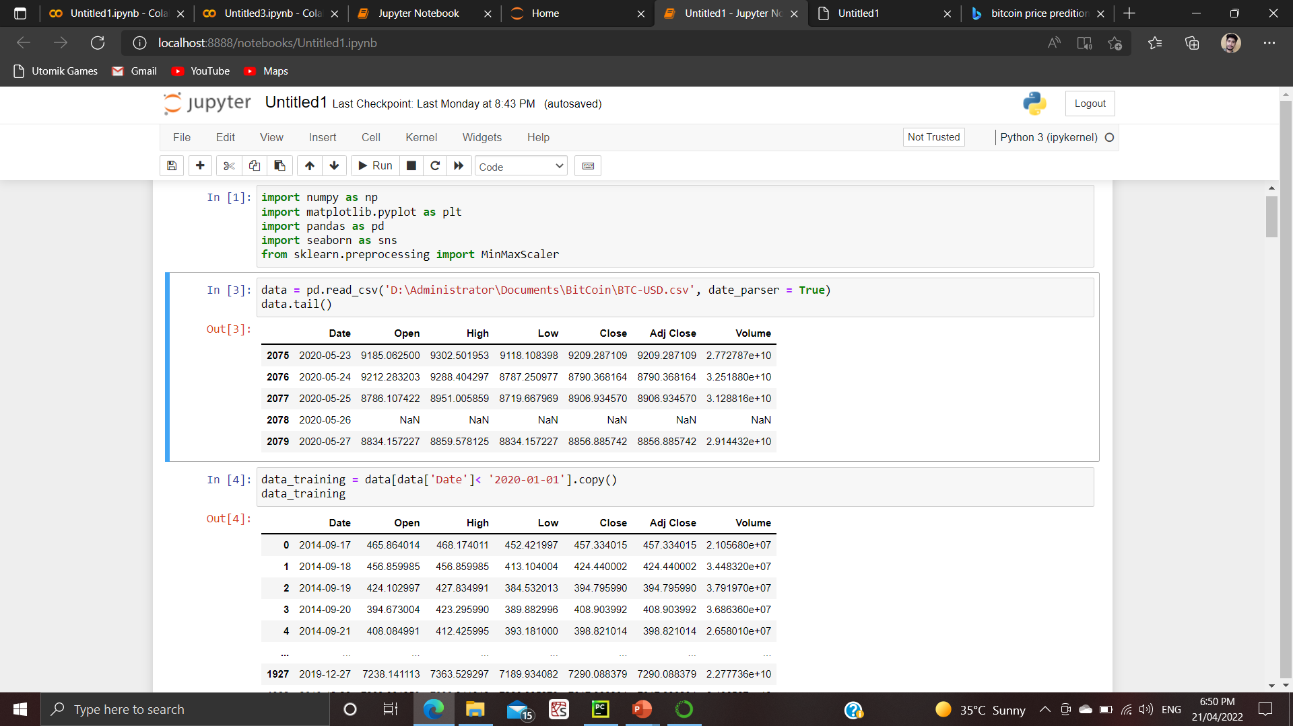

Slide 13
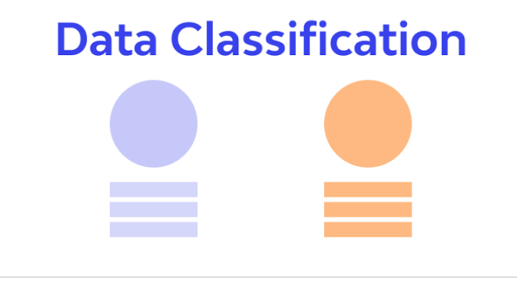
Data Categorization
The data should ideally be divided into 2 sets – namely, Train set and Test set.
Train set
The train set would contain the data which will be fed
into the model.
Test set
The test set contains the data on which we test the
trained and validated model.

Slide 14
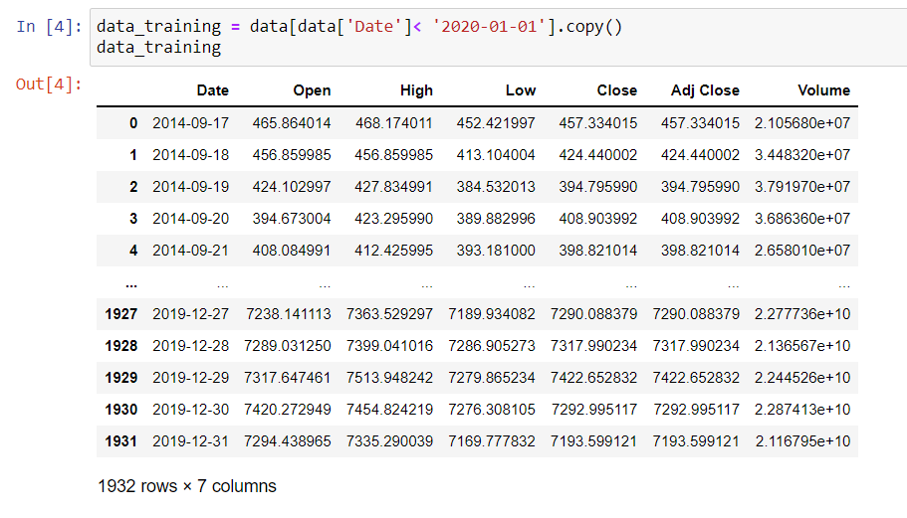

Slide 15
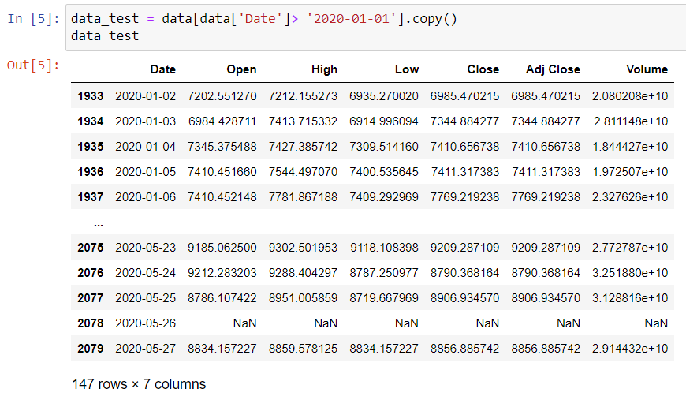

Slide 16
Data Preprocessing
Data Pre-processing is required tasks for cleaning the data and making it suitable for a model which also increases the accuracy and efficiency of the model.
Data Cleaning
Data cleaning is the process of adding missing data and correcting, repairing, or removing incorrect or irrelevant data from a data set.
Data Transformation
Data transformation will begin the process of turning the data into the proper format(s) you’ll need for analysis process.

Slide 17
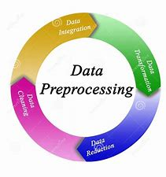
Data Integration
Data Integration involves combining data residing in different sources and providing a unified view.
Data Reduction / Dimension Reduction
Dimensionality reduction refers to techniques that reduce the number of input variables in a data set.

Slide 18
Model Implementation & Predicting
This module includes: 1. Layers Addition
2. Model Training
3. Model Testing
Layers Addition
Here we add layers using add() to neural network.
Weights are assigned to each layer randomly by trail and error.
“Relu” activation function is used to work with the model.

Slide 19
Model Training
Training a model is a process in which an algorithm is fed with training data from which it can learn.
Model training is the primary step in deep learning, resulting in a working model that can be validated, tested, and deployed.
The quality of the training data and the choice of the algorithm are central to the model training phase.
This phase also involves in fitting the model properly. And it can be done by based on Training Loss Vs Validation Loss graph.

Slide 20
Model Testing
At final stage, model will be tested to check its accuracy.
Before testing, the model is again initialized to predict the future values based on what it was fed with training data.
And then, those values are compared graphically with its actual values which are stored in test data set.
Finally, one can understand how accurate the model was. And test with different layers to get better results.

Slide 21
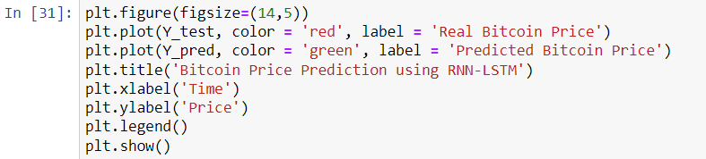

Slide 22
CONCLUSION
So, finally we have concluded that during the project development, we had learnt many things of Neural networks. And also, it is very important of each minor work piece to carry out the model accurately to yield the results.

Slide 23
REFERENCES
1. G. Solomon, “Project-Based learning: A Primer,” Technology Learning, volume 23, Jan. 2003.
2. H. Ince, T.B. Trafalis, “Short term forecasting with support vector machines and applications to stoke price prediction,” International Journal of General Systems, 37, 677-687, 2008.
3. W. Hunag, Y. Nakamori, S. Y. Wang, “Forecasting stock market movement direction with support vector machine,” Computers and Operations Research 32, 2513-2522, 2005.
4. Data collection reference, “BTC-USD 39,850.71 -2650.04 -6.24 : Bitcoin USD - Yahoo Finance”.

Slide 24
THANK YOU

